Slide 1
pi-Temperature Terminal

Slide 2
Aim
The aim of my project was to create a web app that uses the data stored into remote database.
The only restriction on my project was to make it as simple as it can, and effective.

Slide 3
Procedure
The temperature logger consists of two parts:
The first part is database, myLogger.db is created into /var/www using sqlite3. time and temperature data was populated using given .csv file and imported into myTemp table.
Second, a script called highchartAPI.php created to to read the data from table created into myTemp from database and reload the data every 5 minutes. This script also includes the html web app which displays the temperatures in javascript area chart using highchart APIs.

Slide 4
Procedure
To prepare the raspberry pi for the web server and database, I had to install some packages like;
Sqlite3
PHP
Lighttpd
After some initialization on installed packeges, I had successful communication between web-server and database.
I decided to work on raspberry-pi thru SSH since I wanted to access my web page remotely.
At one point I had decided to use the Google chart for my web app but than I realize, it was very time consuming.

Slide 5
Procedure
Finally without going into more detail I decided to use highcharts for my web page.
At last, for my web page, I had to write the html web page that includes php script to connect to database and retrieve the data from it and plot using highchart javascript.

Slide 6
Complications
Thru out the project, major problem was occurred during initialization of highcharts and google charts.
Highchart requires .js library to initialize the highchartAPI. I was having issue installing it to raspberry pi.

Slide 7
Result
This project was challenging and interesting at the same time.
I successfully designed the intended webapp that recalls the database for data.

Slide 8
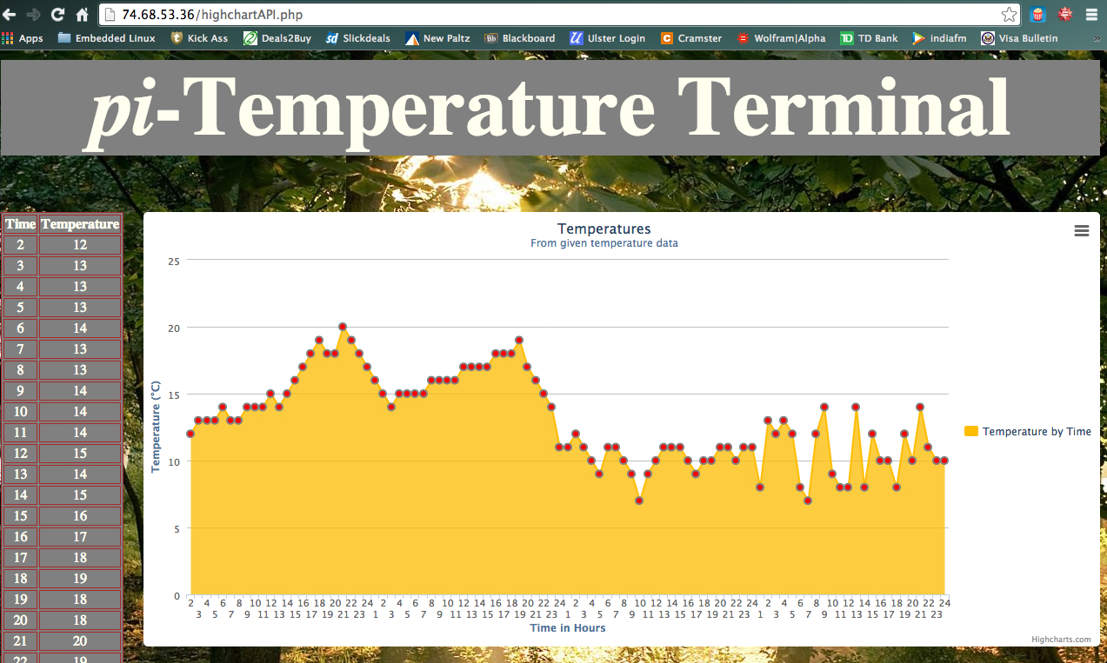
Output

Slide 9
Conclusion
Raspberry pi is very powerful tool that I have came across. My project was relatively simple and easy but I learned lot of stuff that I haven't had knowledge of.
From this project and course, I developed my skills to the Linux Command Line
I also learned javascript and python coding skills from this project.

